Slide 1
Course Code: CSC211A Course Title: Formal Languages and Automata Theory
Lecture 38:Chomsky Hierarchy of Languages
Course Leader:
Prakash P
prakashp.cs.et@msruas.ac.in

Slide 2
Session Objectives
At the end of this session, student will be able to
Explain unrestricted grammars
Describe Context-Sensitive Grammars
Discuss Chomsky Hierarchy

Slide 3
Session Topics
Unrestricted Grammars
Context-Sensitive Grammars
Chomsky Hierarchy

Slide 4
Unrestricted Grammars
Productions
String of variables
and terminals
String of variables
and terminals

Slide 5
Unrestricted Grammars
Example unrestricted grammar:

Slide 6
Unrestricted Grammars
Theorem:
A language is recursively enumerable if and only if is generated by an unrestricted grammar

Slide 7
Context-Sensitive Grammars
Productions
String of variables
and terminals
String of variables
and terminals
and:

Slide 8
Context-Sensitive Grammars
The language
is context-sensitive:

Slide 9
Context-Sensitive Language
Theorem:
A language is context sensitive if and only if
is accepted by a Linear-Bounded automaton

Slide 10
Context-Sensitive Language
Observation:
There is a language which is context-sensitive
but not recursive

Slide 11
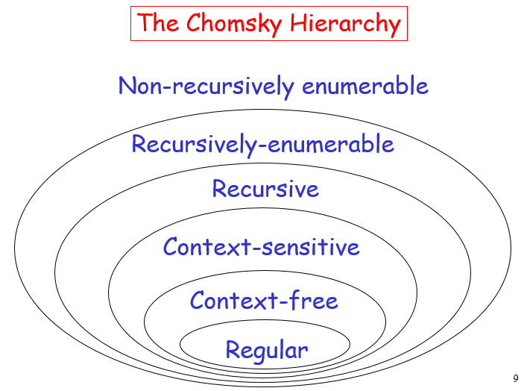
Chomsky Hierarchy

Slide 12
Summary
A language L is recursively enumerable if and only if L is generated by an unrestricted grammar
A language L is context sensitive if and only if
L is accepted by a Linear-Bounded automaton

